Slide 1

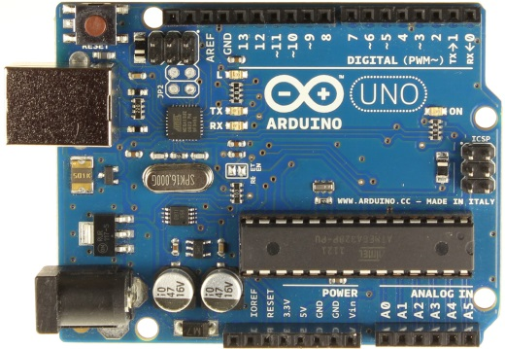
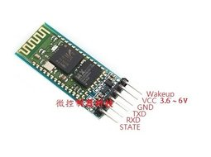
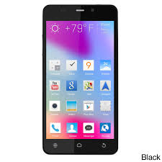
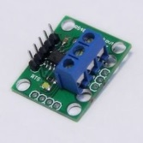

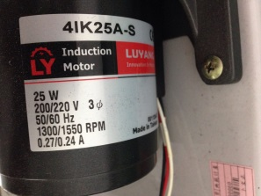
台達變頻器 + AC motor + arduino + android
Arudino
Modbus Master
Host PC
Android phone
USB
Debug
HC-05
Software Serial
TTL to Bluetooth
Max485
Software Serial
TTL to RS485
Bluetooth
Serial (RS-485)
TTL
Internal signal
USB
AC motor
220V 3Phase
變頻器 VFD-M
Modbus slave

